Slide 1

7 / 4 / 24
Notes:
1

Slide 2

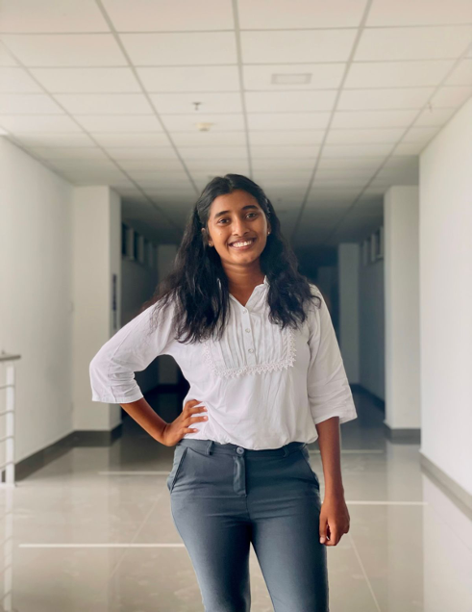
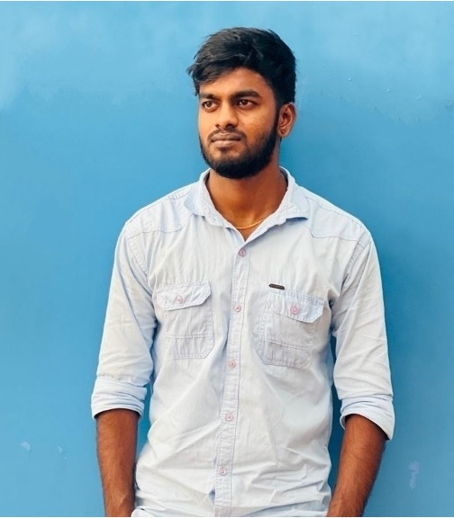
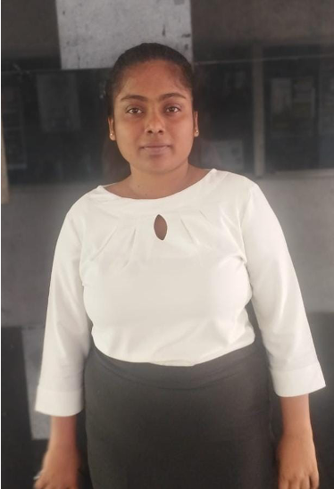

OUR TEAM
72
IT21085062
IT21102646
IT21083228
Our TE
Shangavi.G
Kajanan.T
Venuganth.A
Methiny.S
IT21069772
IT21085062
IT21102646
IT21083228
Supervisor - Ms. Wishalya Tissera
Co-Supervisor - Ms. Karthiga Rajendran
Sangavi.G
Kajanan.T
Methiny.S
Venuganth.A
IT21069772
IT21085062
IT21083228
IT21102646
7 / 4 / 24
1

Slide 3
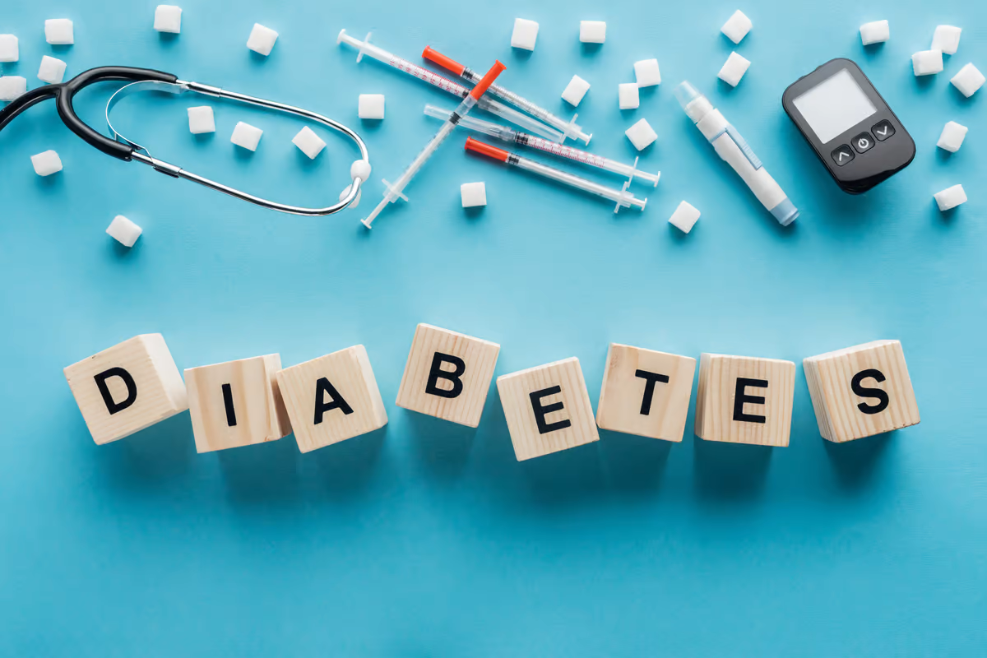

CONTENTS
BACKGROUND
SYSTEM DIAGRAM
INTRODUCTION
RESEARCH QUESTION
RESEARCH PROBLEM
RESEARCH GAP
OBJECTIVES
7 / 4 / 24
3

Slide 4

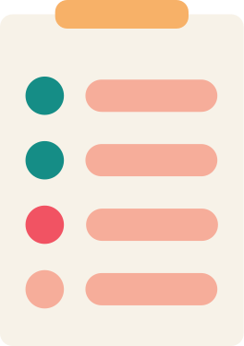

BACKGROUND
What is Decoding Diabetes ?
Why are we focusing on this topic ?
What are the main problems we identified ?
7 / 4 / 24
4

Slide 5
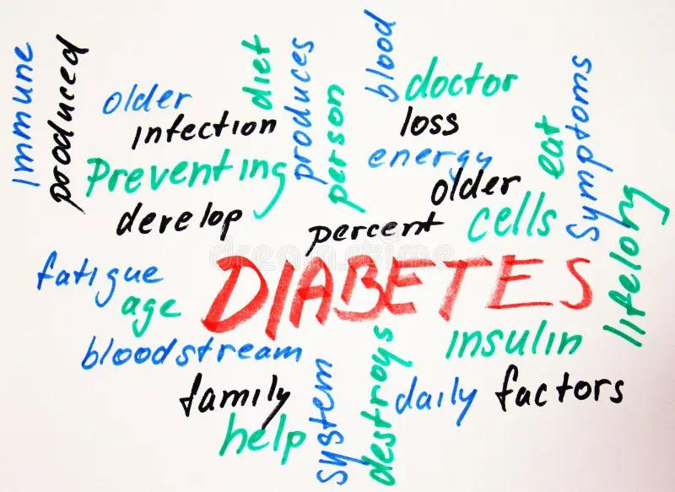
INTRODUCTION
Decoding Diabetes" is a user-friendly app for at-home diabetes risk assessment. It uses machine learning and image processing to analyze neck circumference, foot ulcers, infected nails, and retinopathy images.
•Enables easy diabetes risk assessment from home.
•Identifies potential risks through diverse indicators.
•Simple interface for accessibility to all users.
•Prompts early awareness, contributing to better healthcare outcomes.
7 / 4 / 24
5

Slide 6
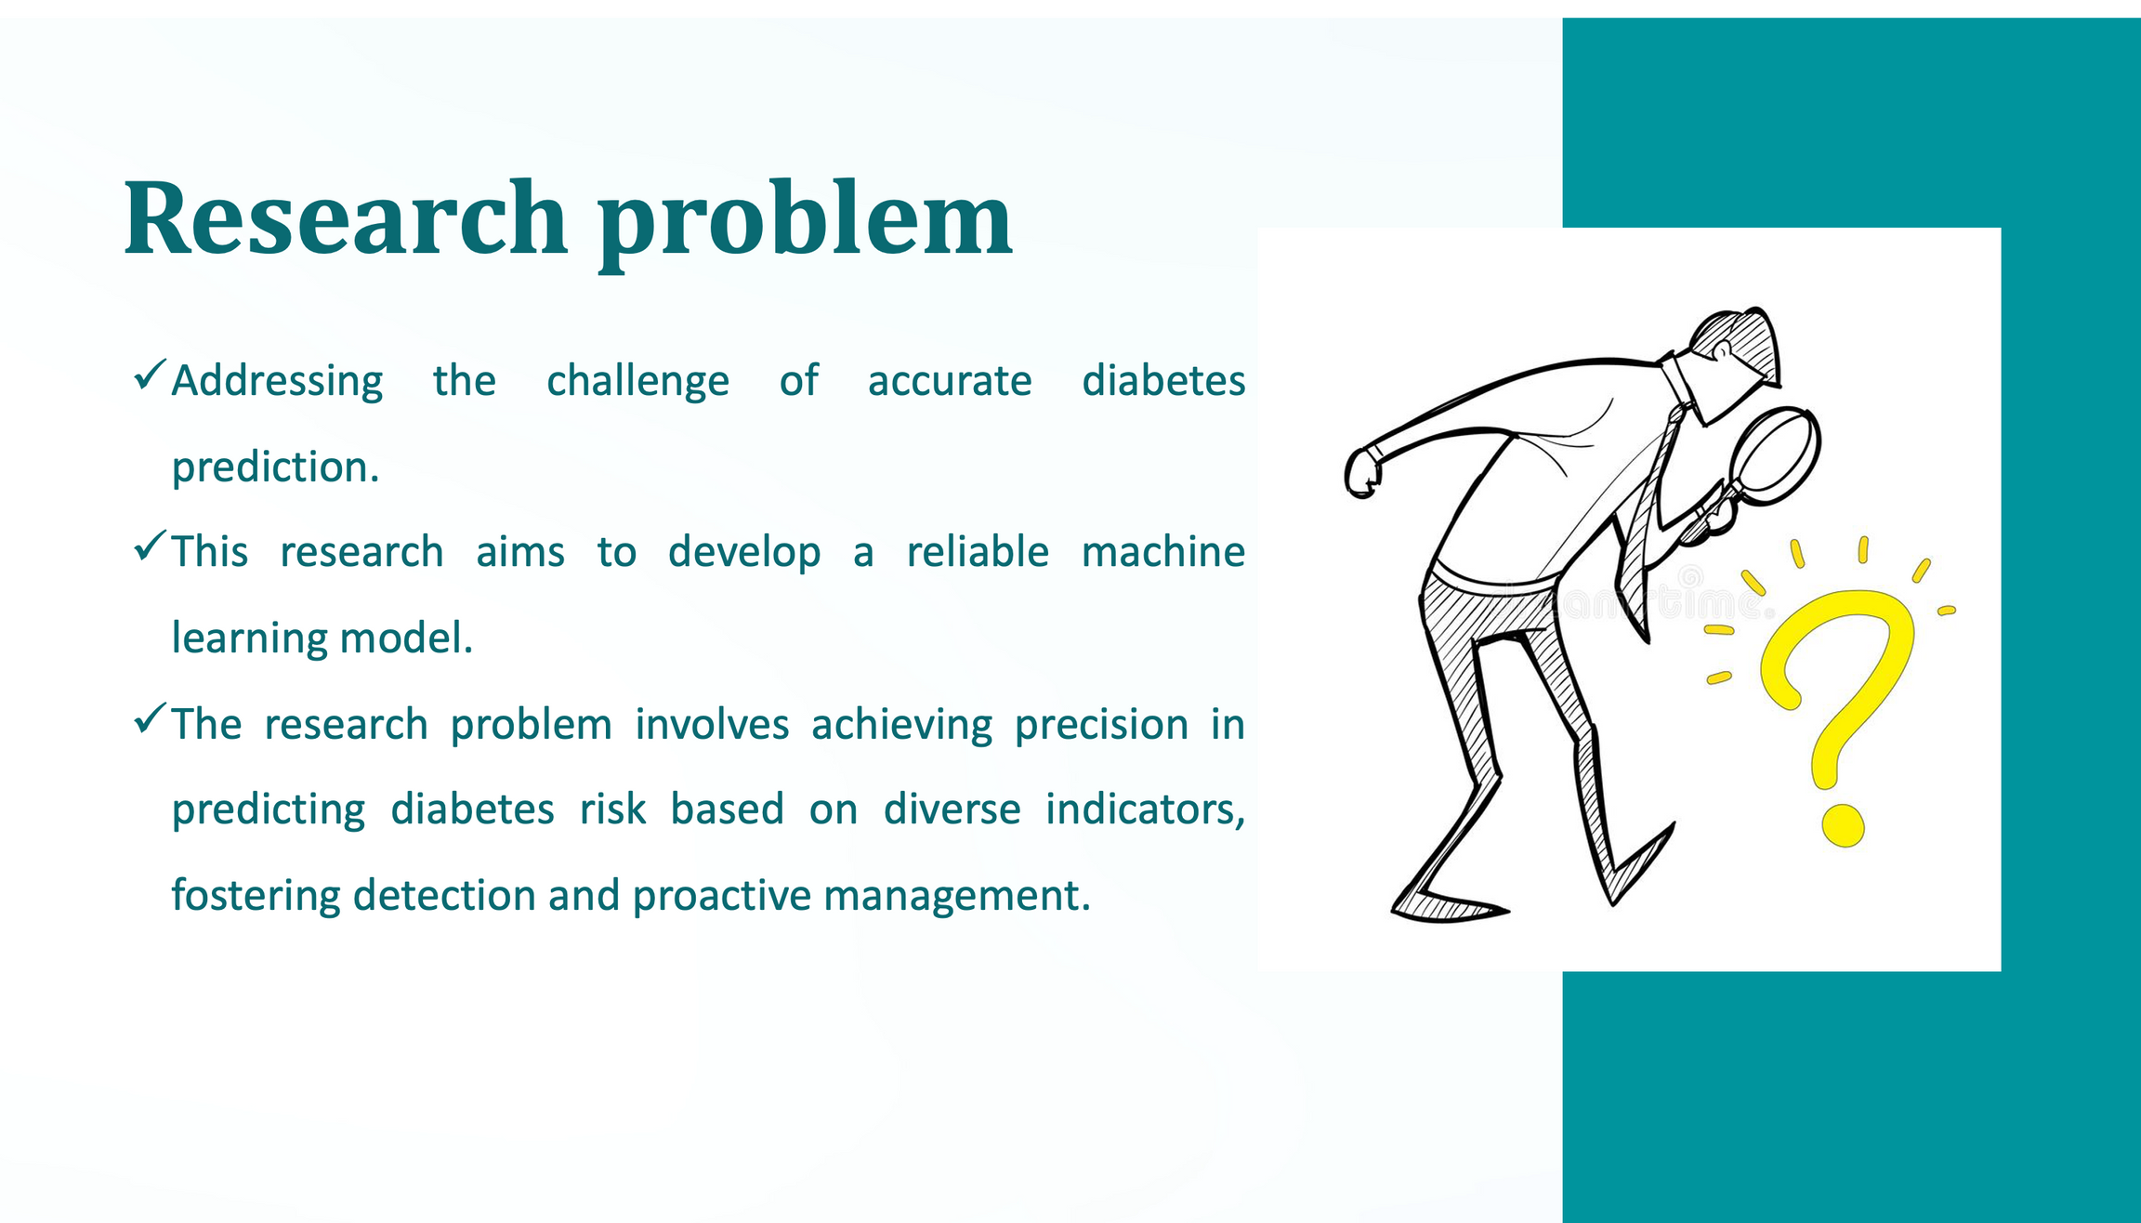
7 / 4 / 24
7

Slide 7
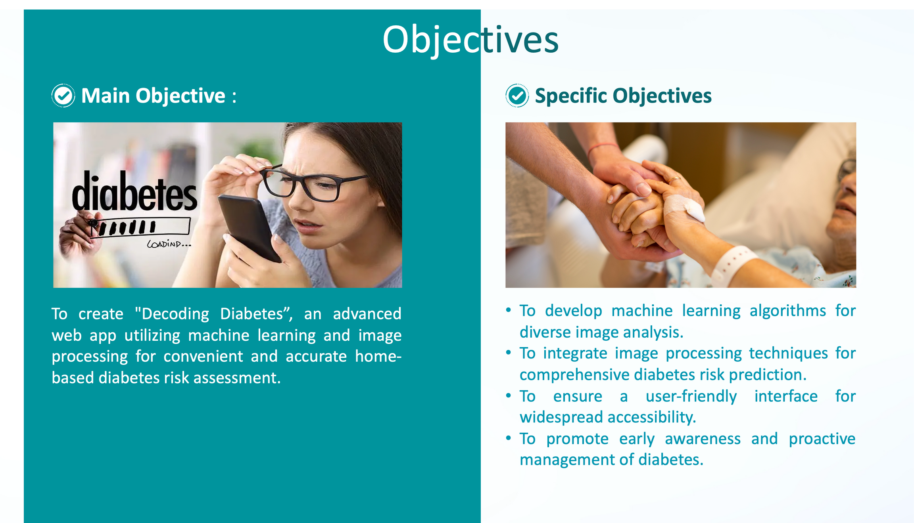
7 / 4 / 24
8

Slide 8
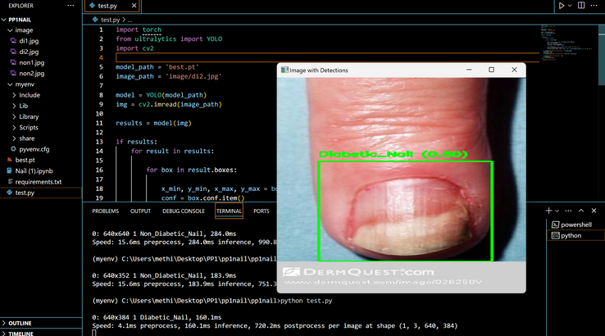
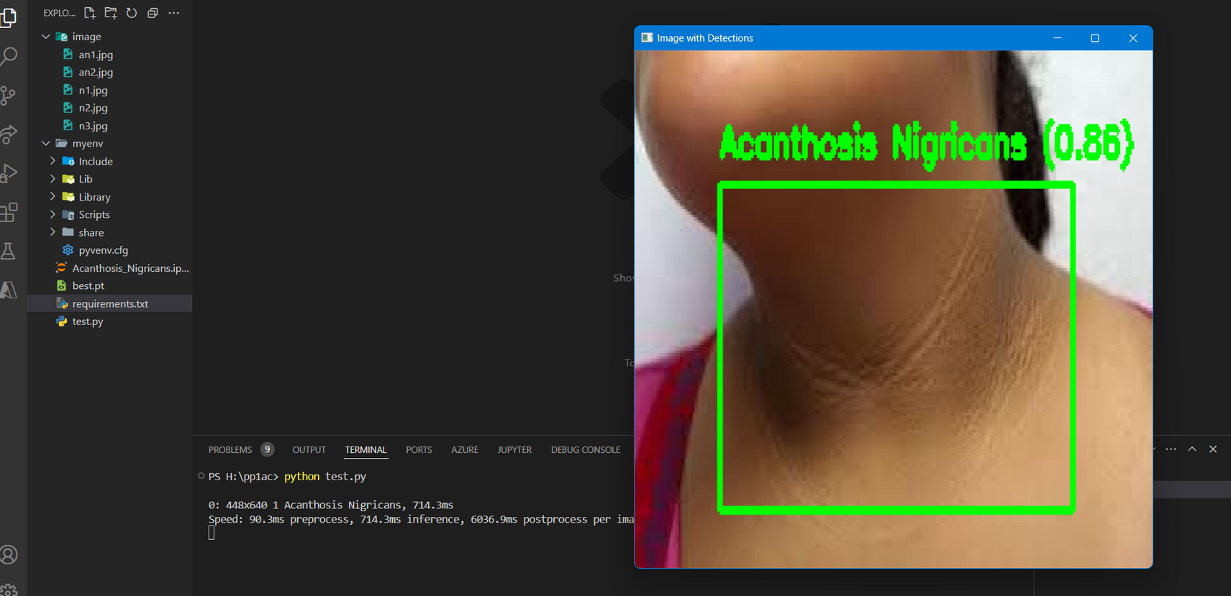
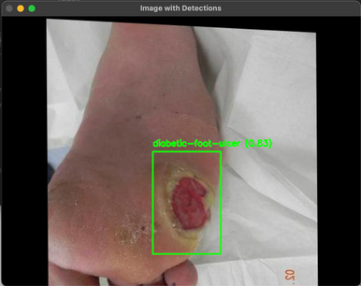
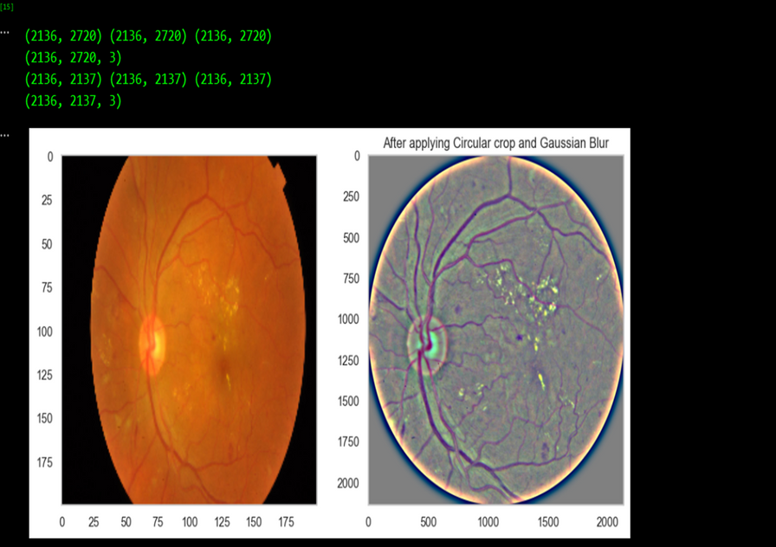
SYSTEM DIAGRAM
NAIL, NECK & FOOT & RETINA
Display Results
CNN (custom CNN).
Nail image
YOLOV8
Neck image
Detected
Image Input
CNN (custom CNN).
Detection
Retinopathy image
Not
Foot image
YOLOV8

Slide 9

RESEARCH GAP
Limited Home-Based Solutions :
Absence of accessible home-based diabetes diagnostic tools for the general user population.
User-Friendly Gap : Existing tools often lack a user-friendly interface, hindering widespread adoption among diverse users.
Lack of Diverse Indicators : Current methods overlook unconventional indicators like neck circumference images, foot ulcers, infected nails, and retinal images in diabetes prediction.
Delayed Detection : The absence of early, comprehensive screening tools contributes to delayed diabetes detection, limiting opportunities for proactive management
7 / 4 / 24
10

Slide 10
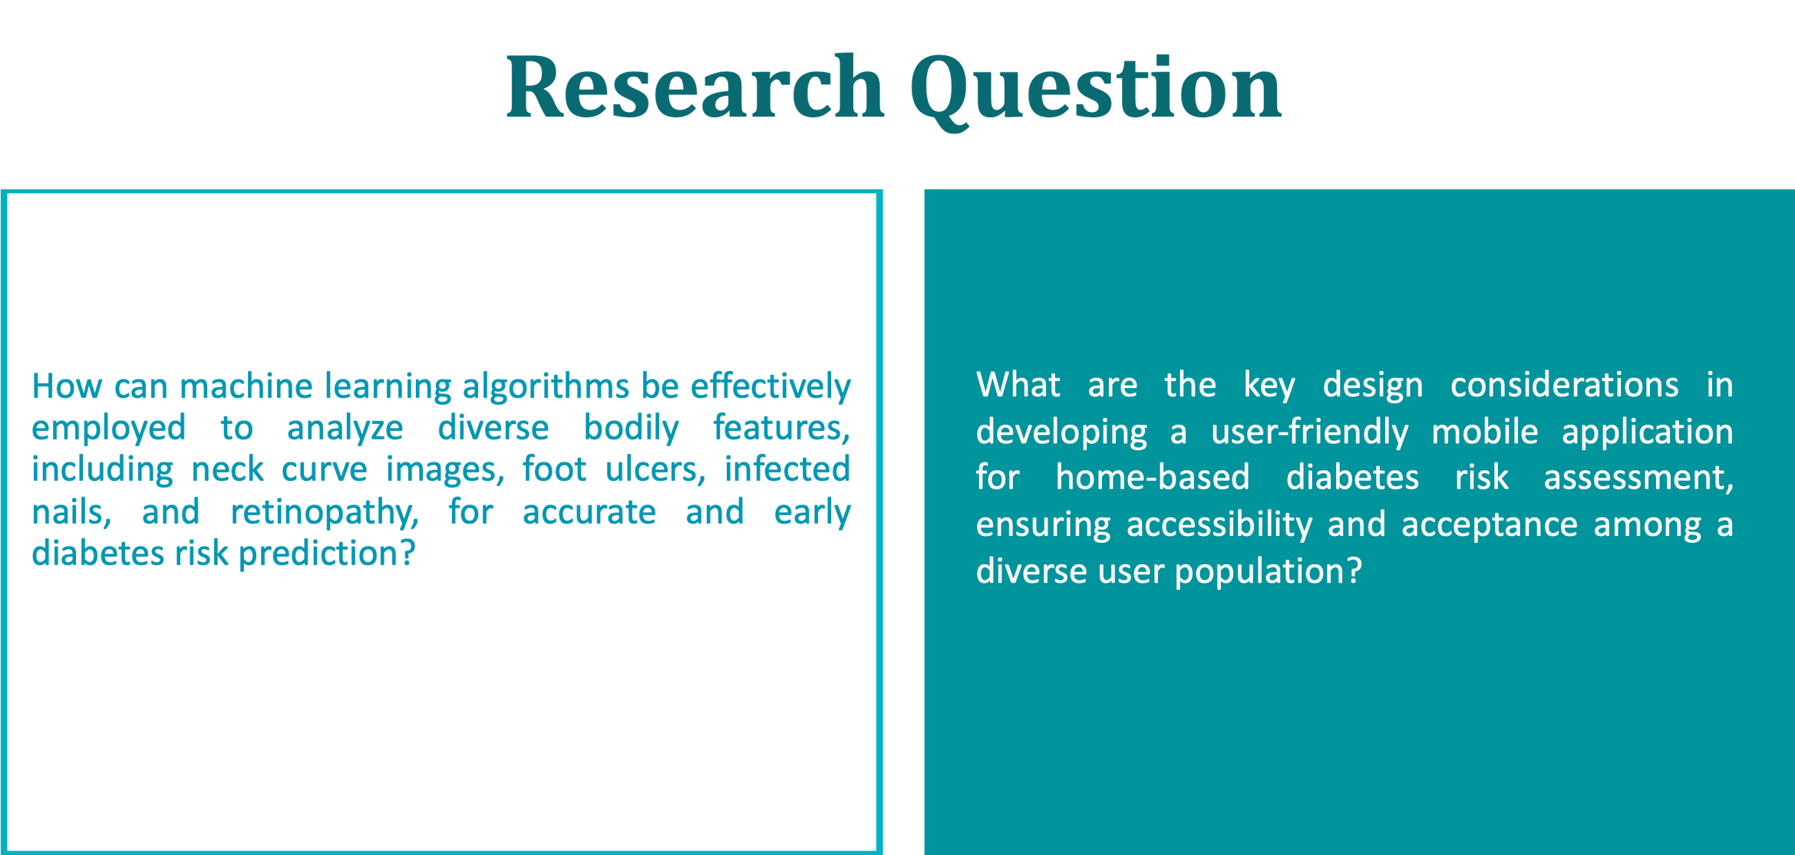
7 / 4 / 24
11

Slide 11
Sangavi G
BSc (Hons) in Information Technology Specialising in IT
Diabetes Detection with
Home-Captured Neck Images
IT21069772
IT21069772 | Sangavi.G | R24-120
7 / 4 / 24
11

Slide 12

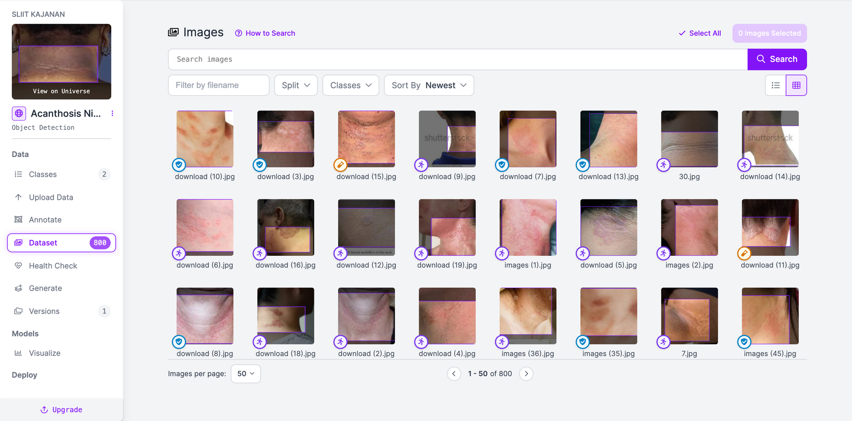

OVERVIEW
Introduction
Objectives
Research Problems
IT21069772 | Sangavi.G | R24-120
7 / 4 / 24
13

Slide 13
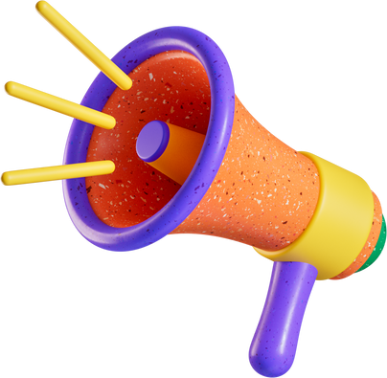

Introduction
What is acanthosis nigricans neck?
One of the core symptoms of Diabetic.
How it is Predicted through ML model?
Analyzing the input image and validate the availability of the pattern.
How Important it is to provide a hand on solution?
Diabetic is becoming a common and mostly unnoted issue.
IT21069772 | Sangavi.G | R24-120
7 / 4 / 24
14

Slide 14


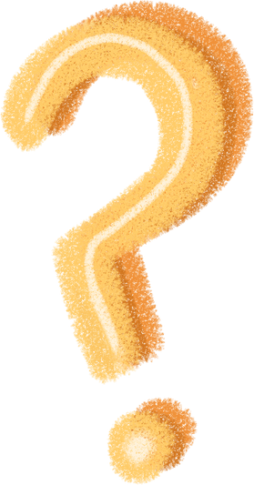
Research Problems
Increase awareness and usage of web base solution for diabetics
Providing more reliable and easily accessed solution than the traditional ways.
IT21069772 | Sangavi.G | R24-120
7 / 4 / 24
15

Slide 15
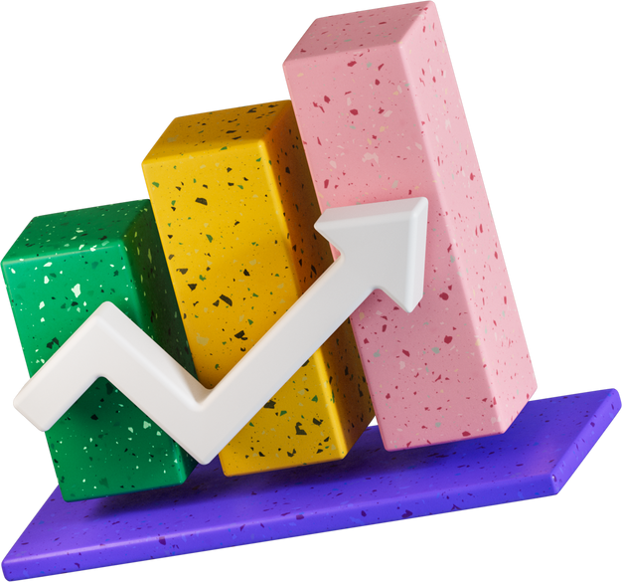
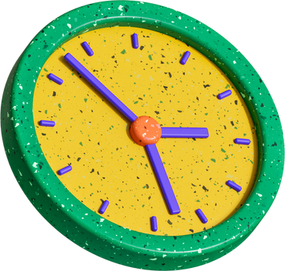
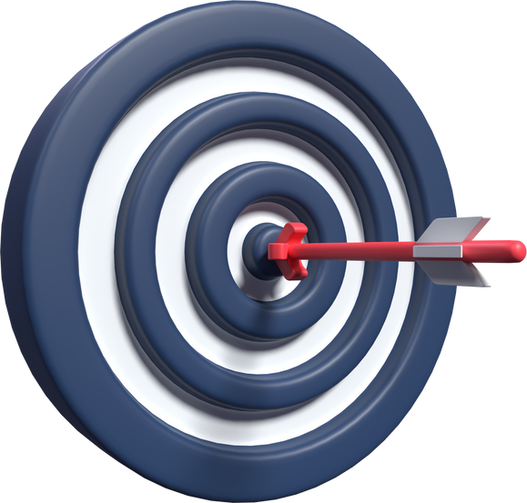

Objective
Providing a hand on solution, which is more reliable
and easily accessed.
Diabetic detection with home captured neck images.
Easily accessed by anyone at any time.
Increased time efficiency.
Detecting early in time.
Providing a model with higher accuracy rate.
IT21069772 | Sangavi.G | R24-120
7 / 4 / 24
16

Slide 16
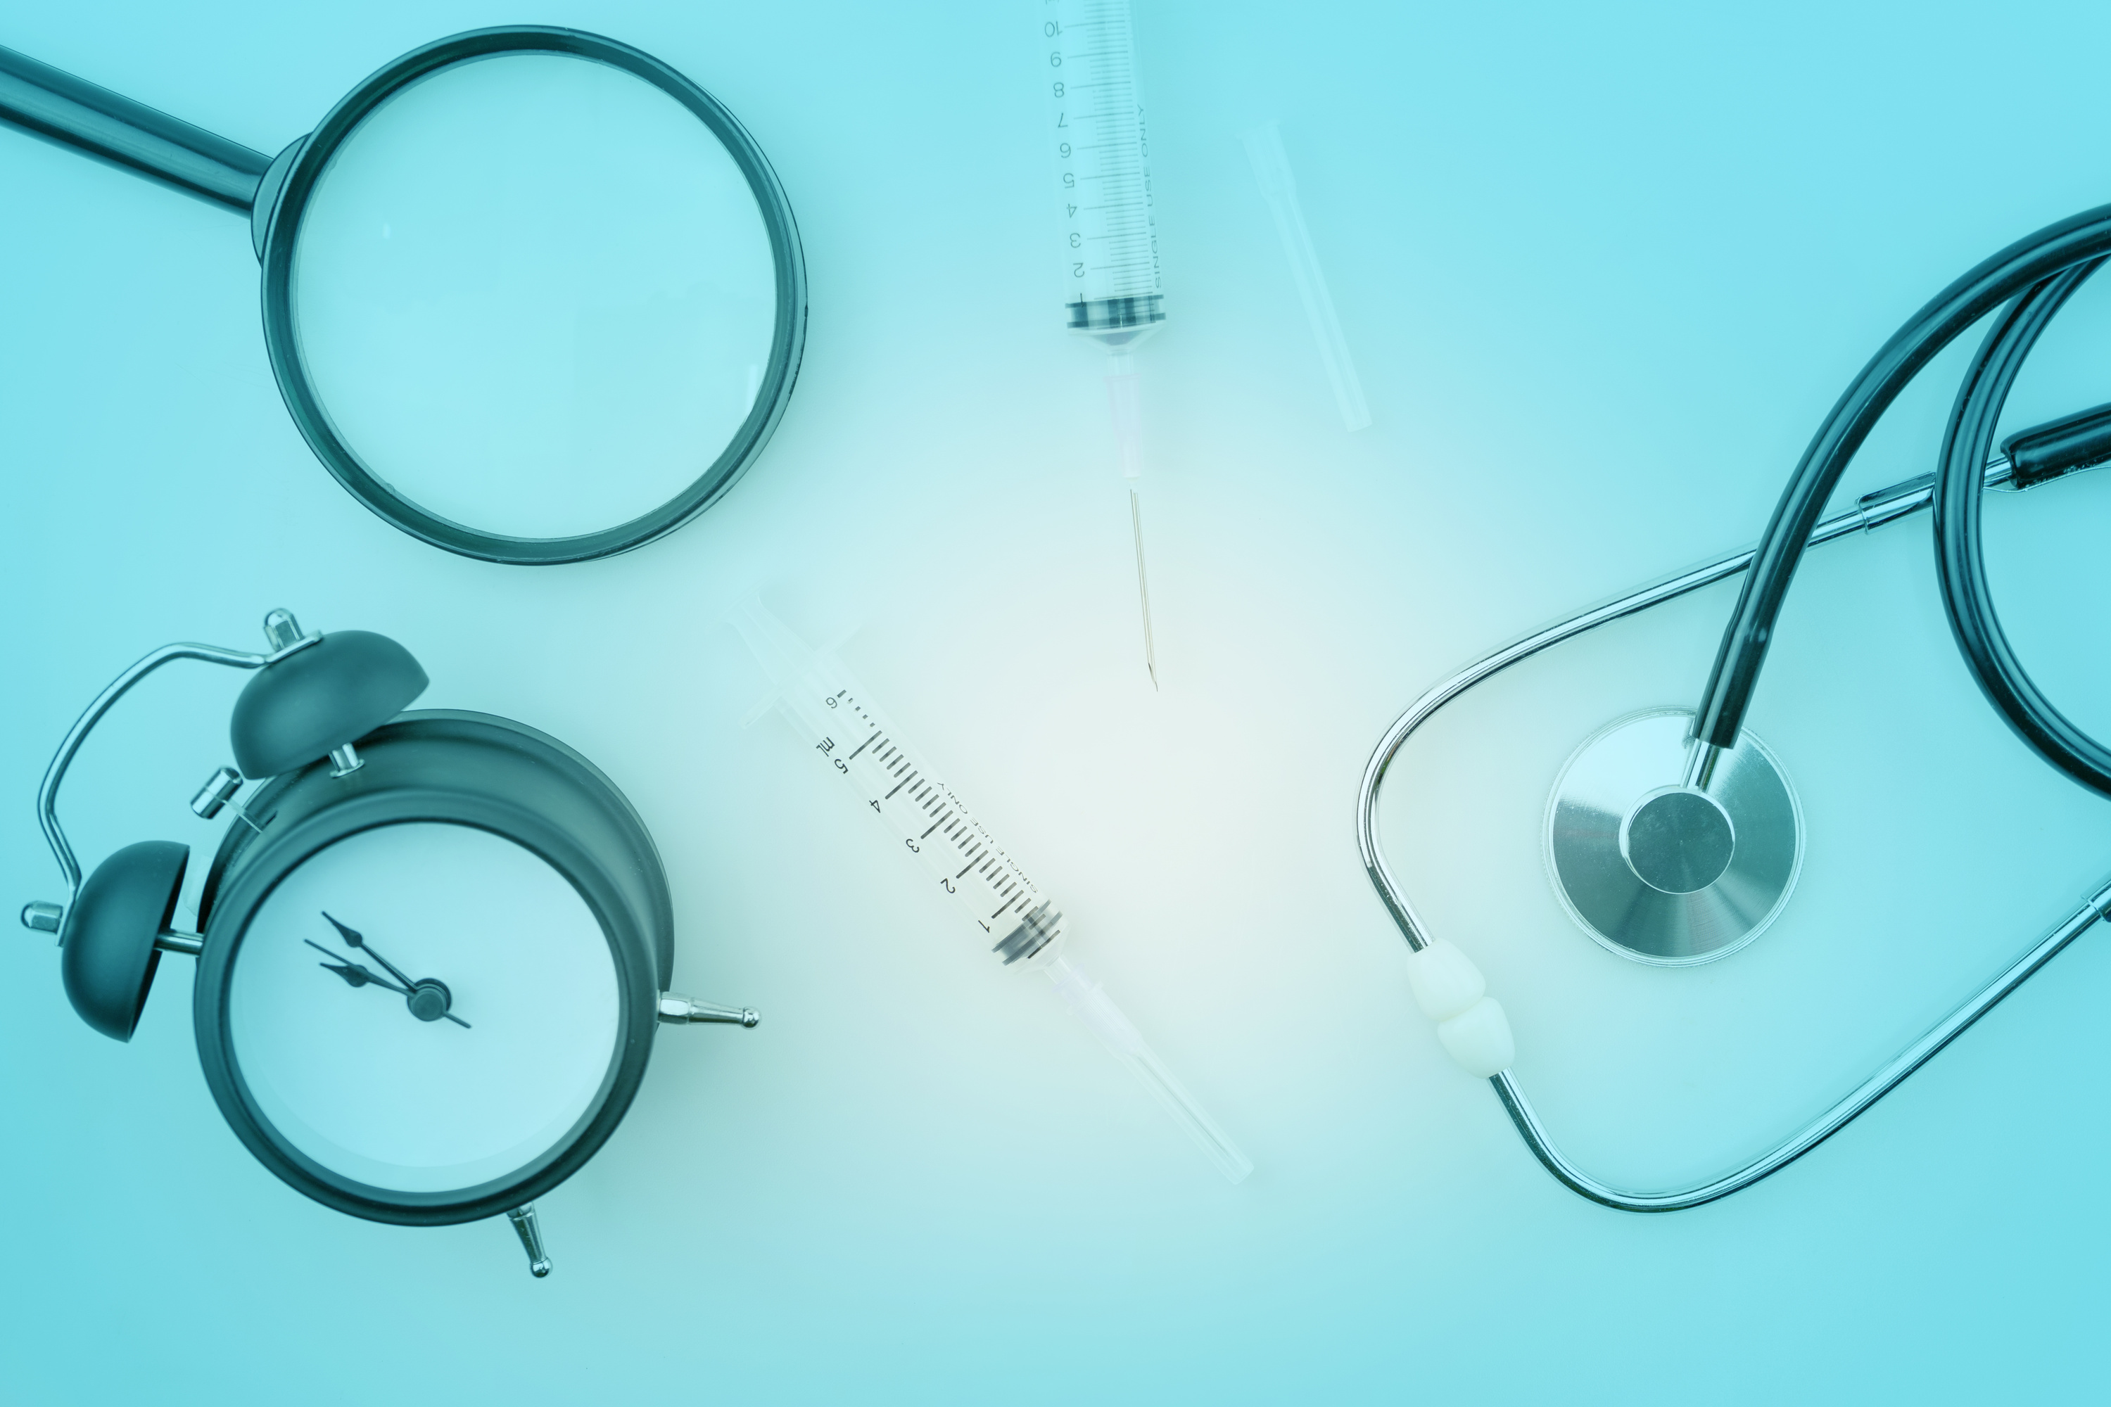
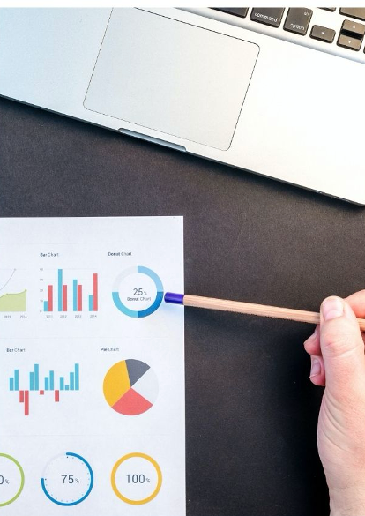
METHODOLOGY
System Diagram
Tools & Technology
Completion of Project
IT21069772 | Sangavi.G | R24-120
7 / 4 / 24
18

Slide 17

System Diagram
Display Results
Detected
Pre-processed object detection model
(Yolo v8)
Detection
Input Image
Image Input
Not

Slide 18
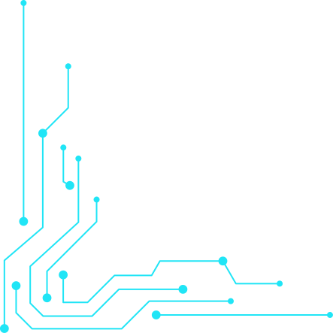

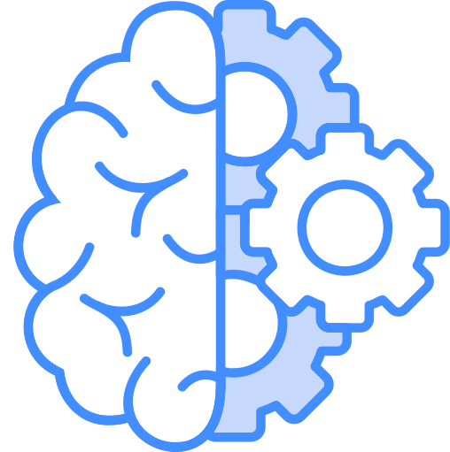

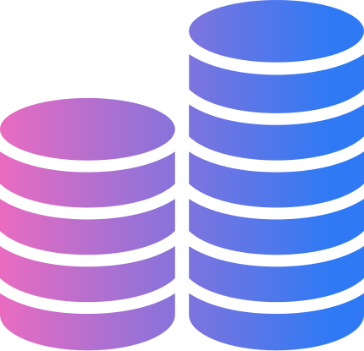


TOOLS & TECHNOLOGY
FRAMEWORKS
PROGARAMMING LANGUAGE
YOLO V8
Roboflow
Python
Next JS
DATABASE
OTHER TOOLS
Firebase
Google Colab
Figma
Draw.io
Canva
IT21069772 | Sangavi.G | R24-120
7 / 4 / 24
19

Slide 19

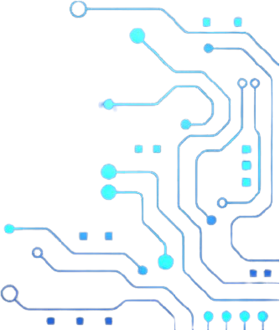
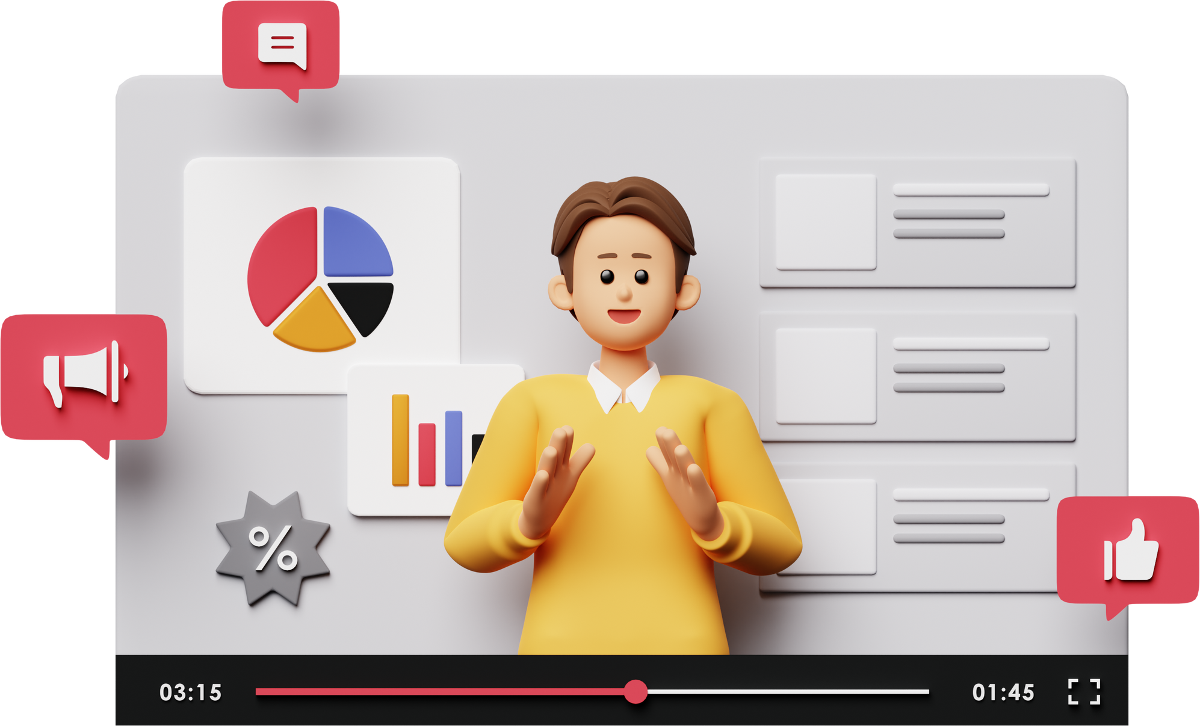
COMPLETION OF THE PROJECT!
IT21069772 | Sangavi.G | R24-120
6 / 4 / 24
20

Slide 20

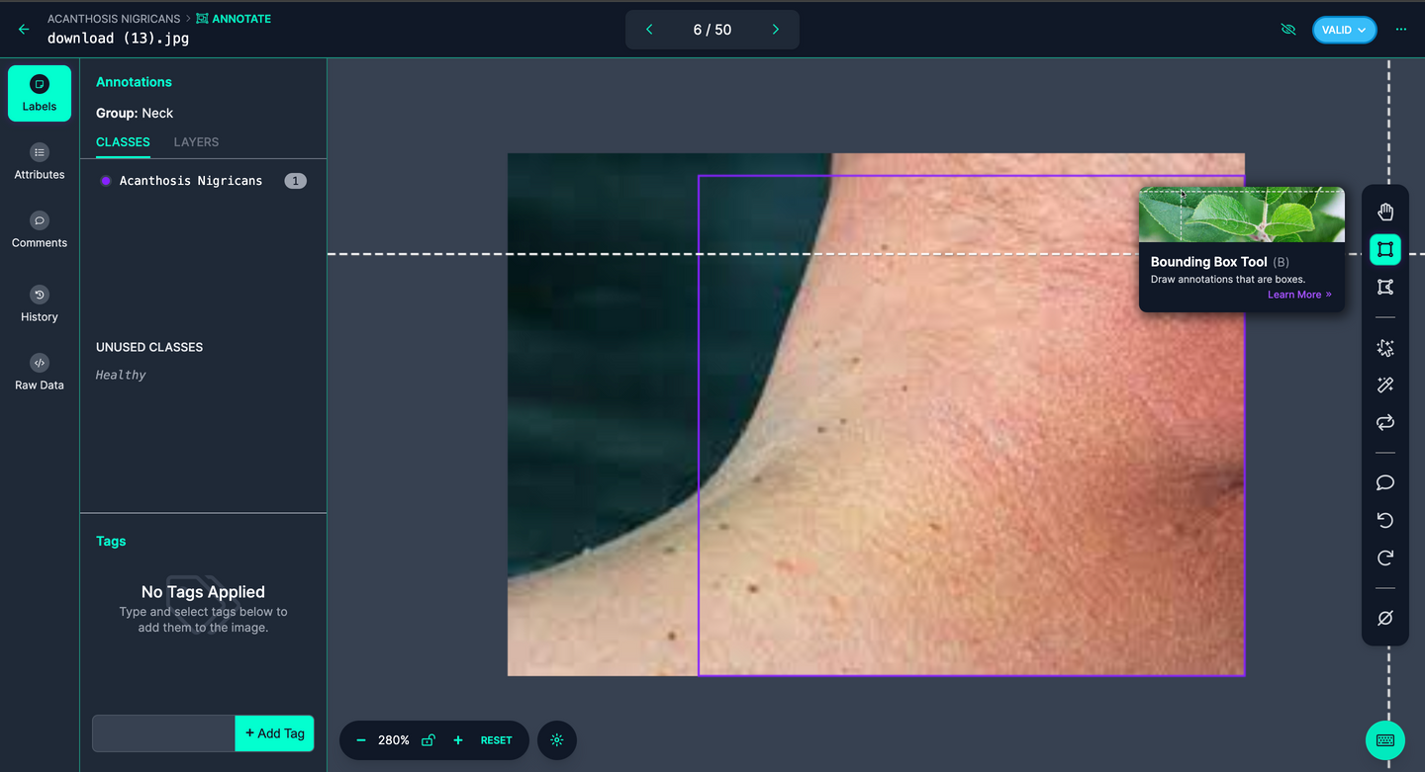

Data Collection
Where?
COLLECTED
How?
IT21069772 | Sangavi.G | R24-120
6 / 4 / 24
21

Slide 21

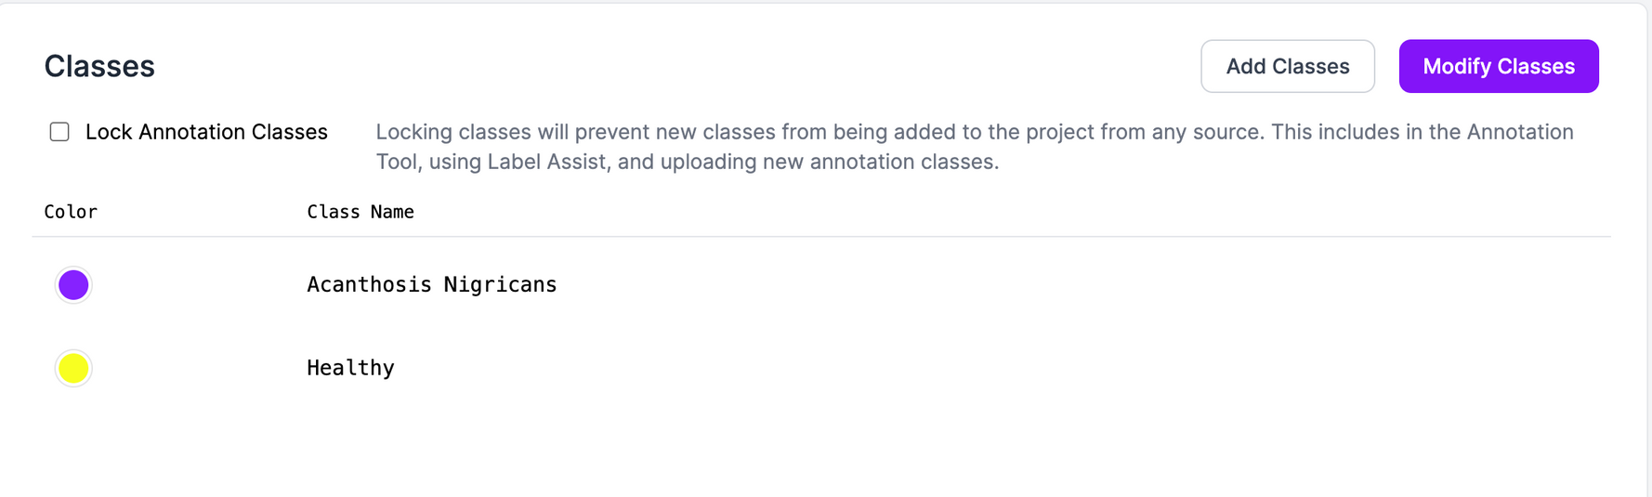
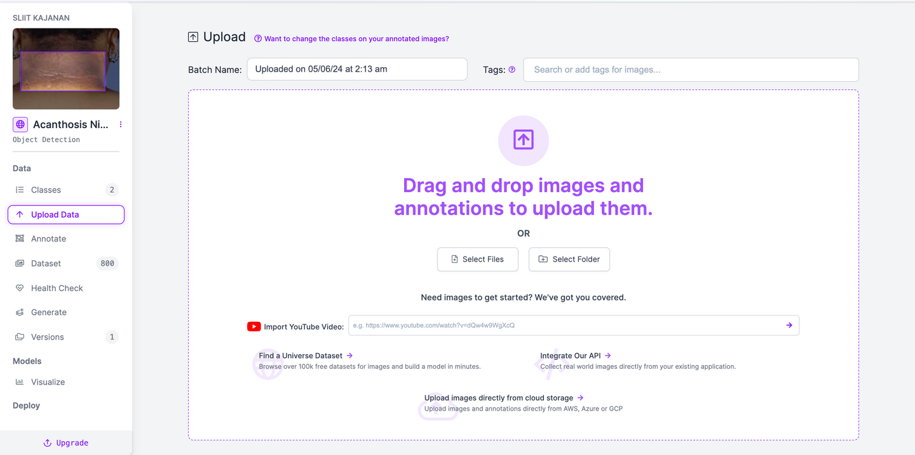
Class Creation
Insert Data
IT21069772 | Sangavi.G | R24-120
6 / 4 / 24
22

Slide 22

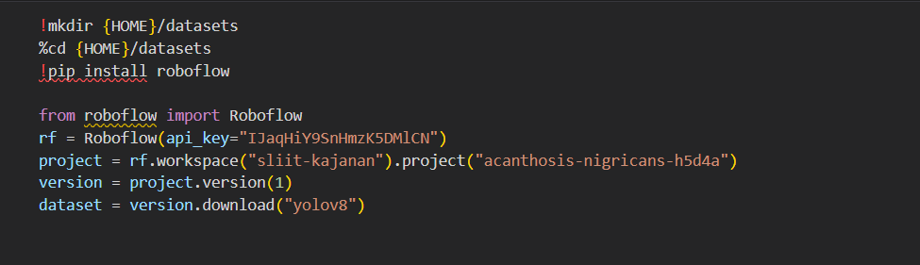
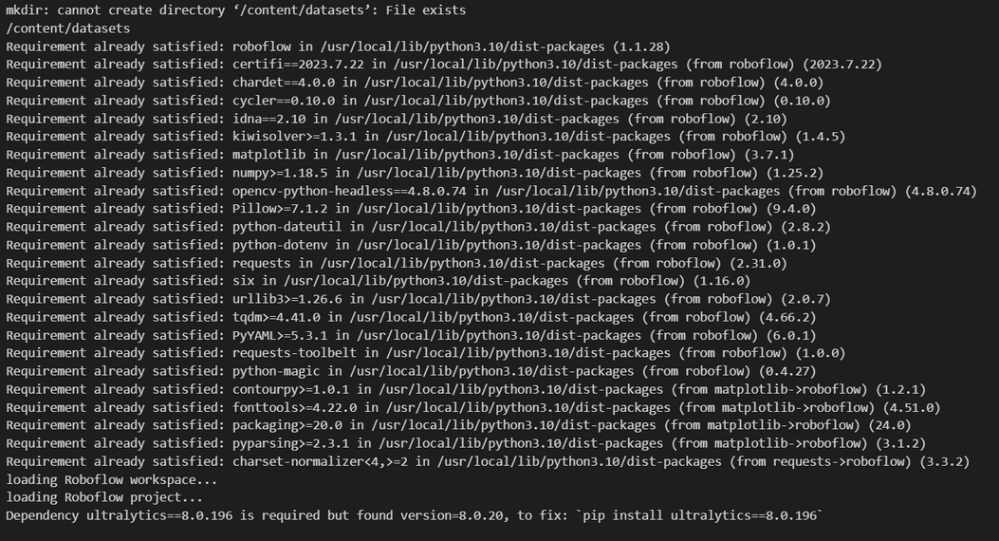

Implement Dataset
IT21069772 | Sangavi.G | R24-120
6 / 4 / 24
23

Slide 23
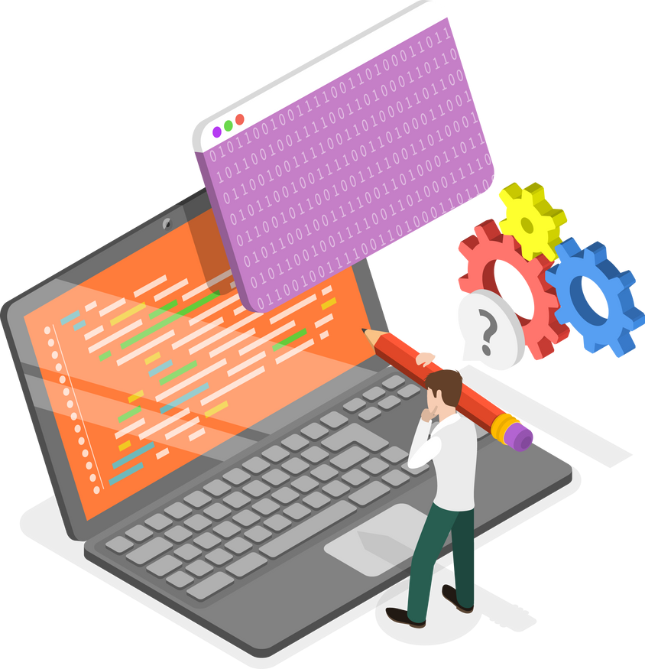

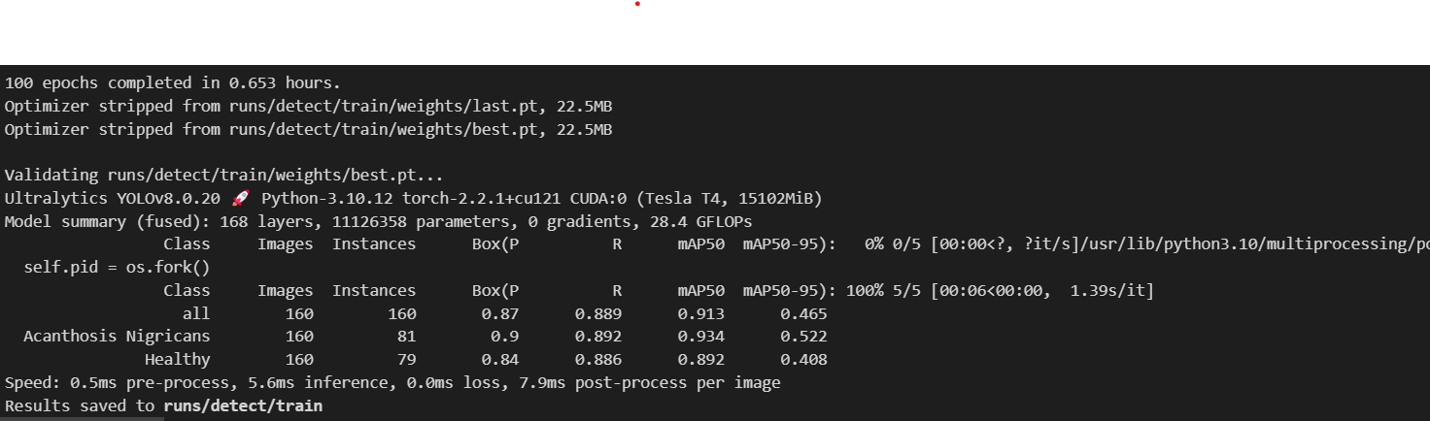
Model Training
IT21069772 | Sangavi.G | R24-120
6 / 4 / 24
24

Slide 24
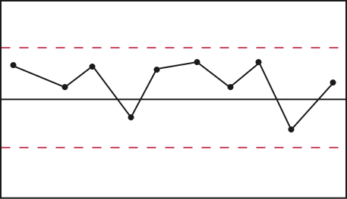
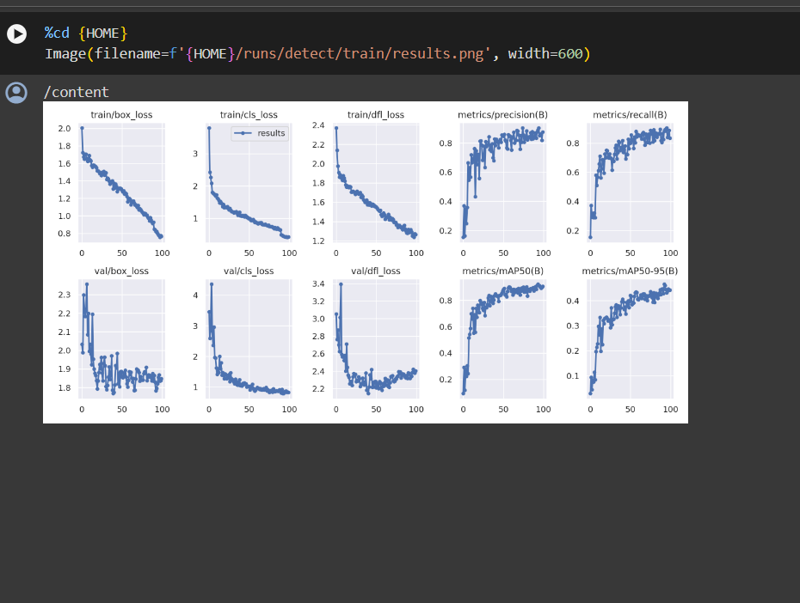
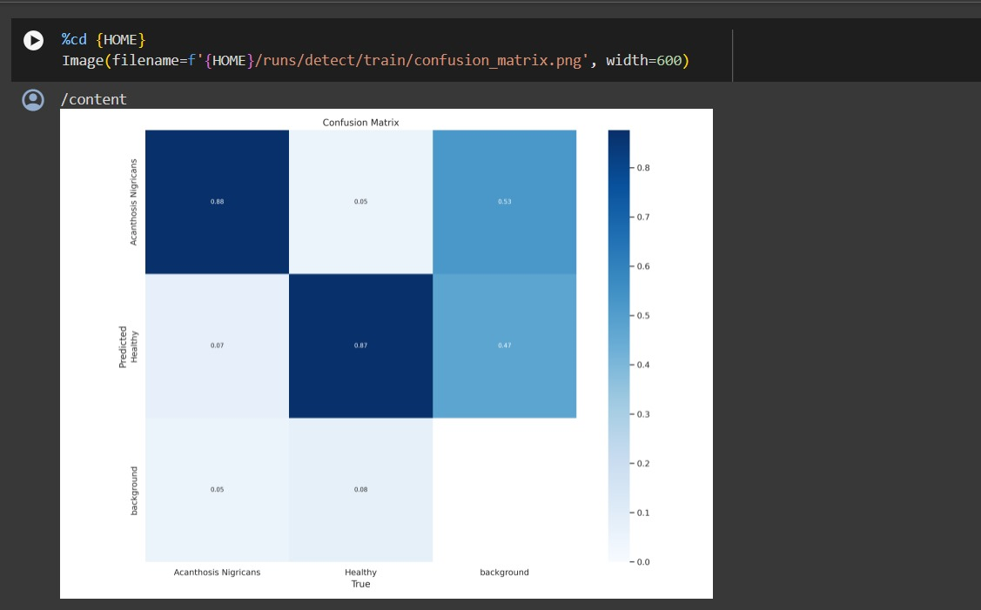
IT21069772 | Sangavi.G | R24-120
6 / 4 / 24
25

Slide 25
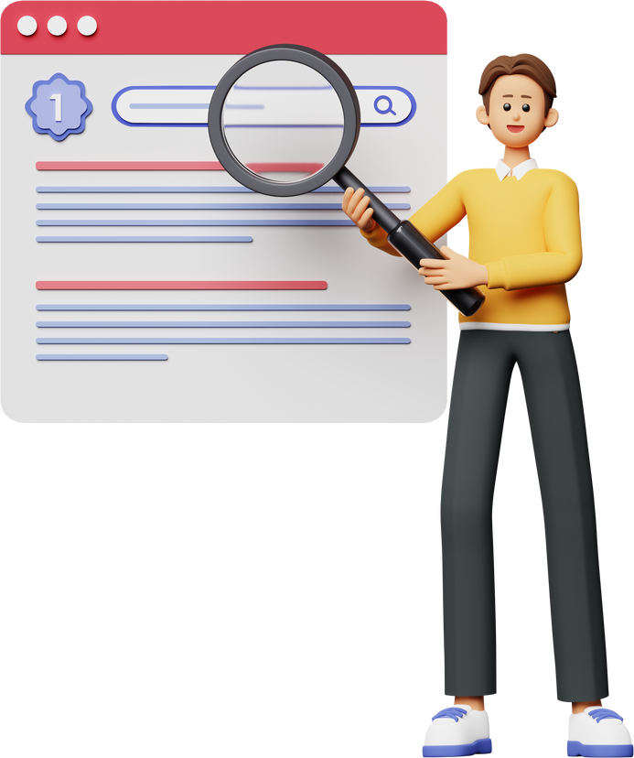

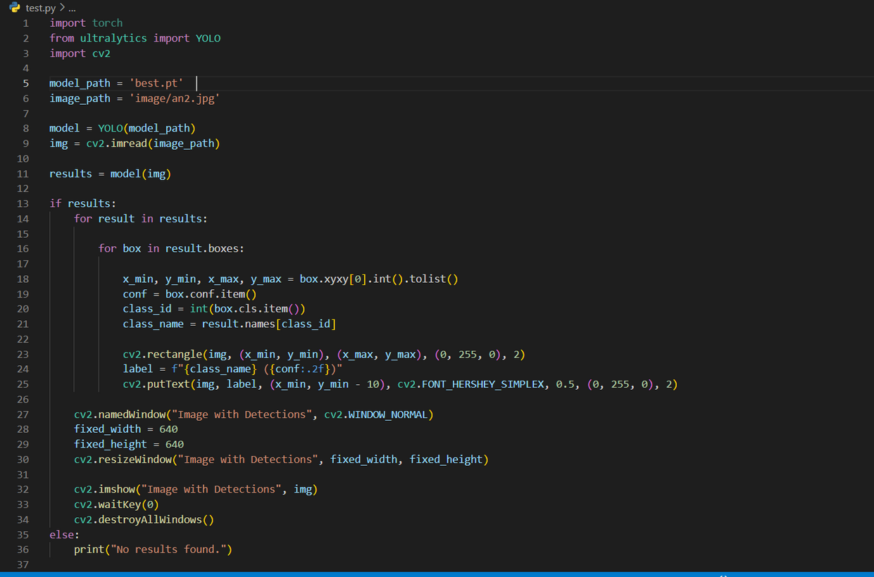

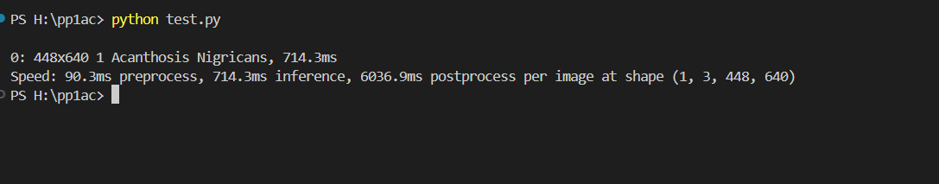
Final Prediction
IT21069772 | Sangavi.G | R24-120
6 / 4 / 24
26

Slide 26
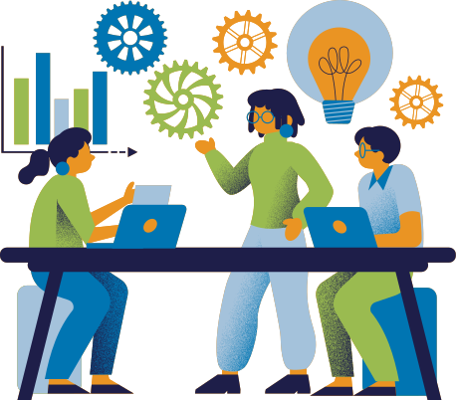
FUTURE PLANS
Finalized Model Deployment and Testing
Implement a Front-end & Back-end
Integration with Back-end
Database Creation & Integration
IT21069772 | Sangavi.G | R24-120
6 / 4 / 24
27

Slide 27
Kajanan T
BSc (Hons) in Information Technology Specialising in IT
Diabetic prediction using foot ulcer
IT21085062
IT21085062 | Kajanan.T | R24-120
6 / 4 / 24
28

Slide 28
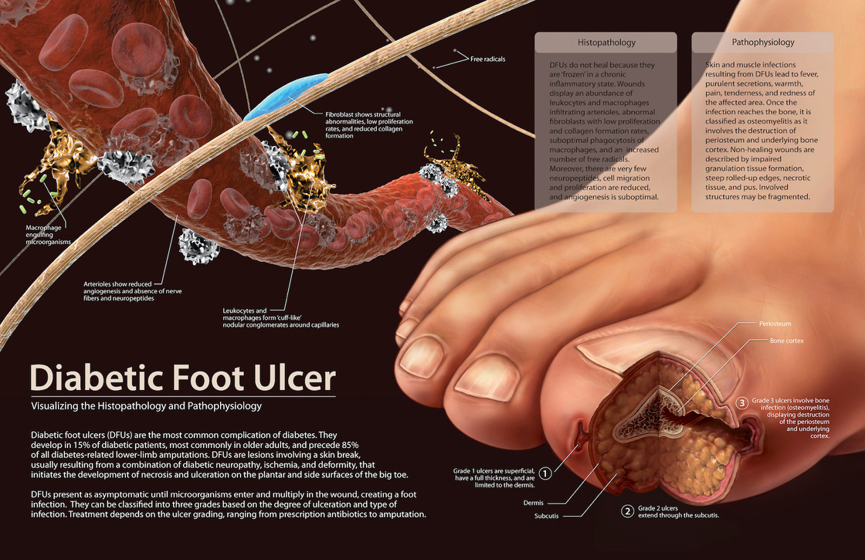
OVERVIEW
Introduction
Objective
Research Problem
IT21085062 | Kajanan.T | R24-120
6 / 4 / 24
29

Slide 29
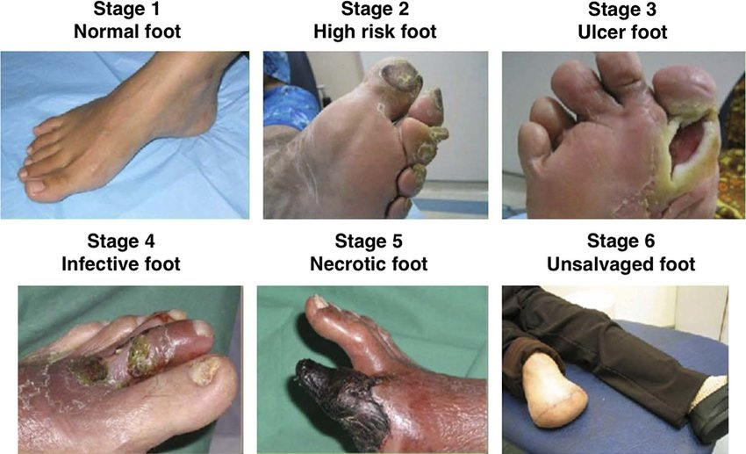
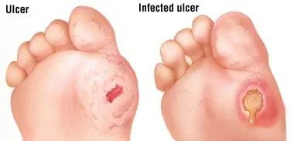
INTRODUCTION
IT21085062 | Kajanan.T | R24-120
6 / 4 / 24
30

Slide 30
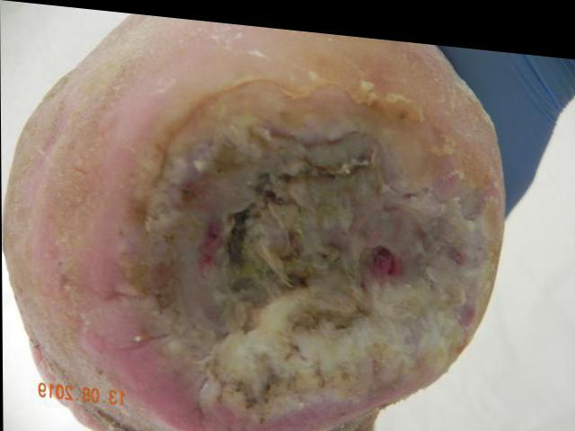
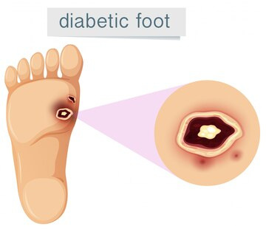
Layer 1
Layer 2
Layer 3
Layer 4
Layer 5
IT21085062 | Kajanan.T | R24-120
6 / 4 / 24
31

Slide 31




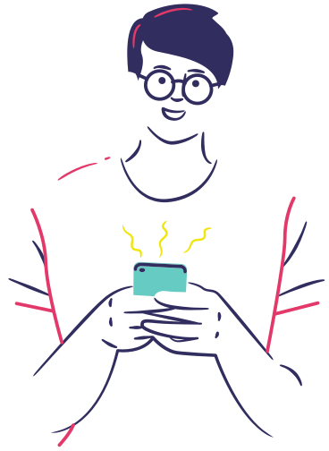
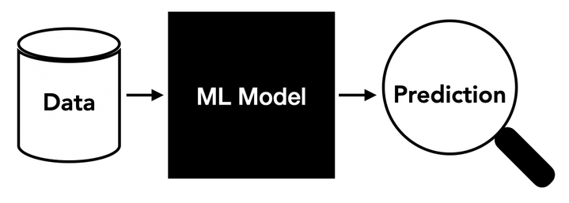
RESEARCH PROBLEM
Addressing the deficiency in diabetes prediction models, this study aims to develop a comprehensive approach focusing on foot wound analysis.
Creating an effective model for accurately predicting diabetes
How can we incresss the awareness towards diabities
Providing a handon solution which is available in day to day life.
IT21085062 | Kajanan.T | R24-120
6 / 4 / 24
32

Slide 32

MAIN OBJECTIVES
SPECIFIC OBJECTIVES
Develop a precise model for diabetes prediction through foot wound analysis, enhancing early detection and tailoring interventions for effective personalized care.
•Optimize machine learning algorithms for accurate foot wound analysis.
•Implement a user-friendly interface for accessibility.
•Conduct rigorous testing to validate the model's accuracy and reliability.
IT21085062 | Kajanan.T | R24-120
6 / 4 / 24
33

Slide 33
METHODOLOGY
System Diagram
Tools & Technology
Completion of Project
IT21085062 | Kajanan.T | R24-120
6 / 4 / 24
34

Slide 34
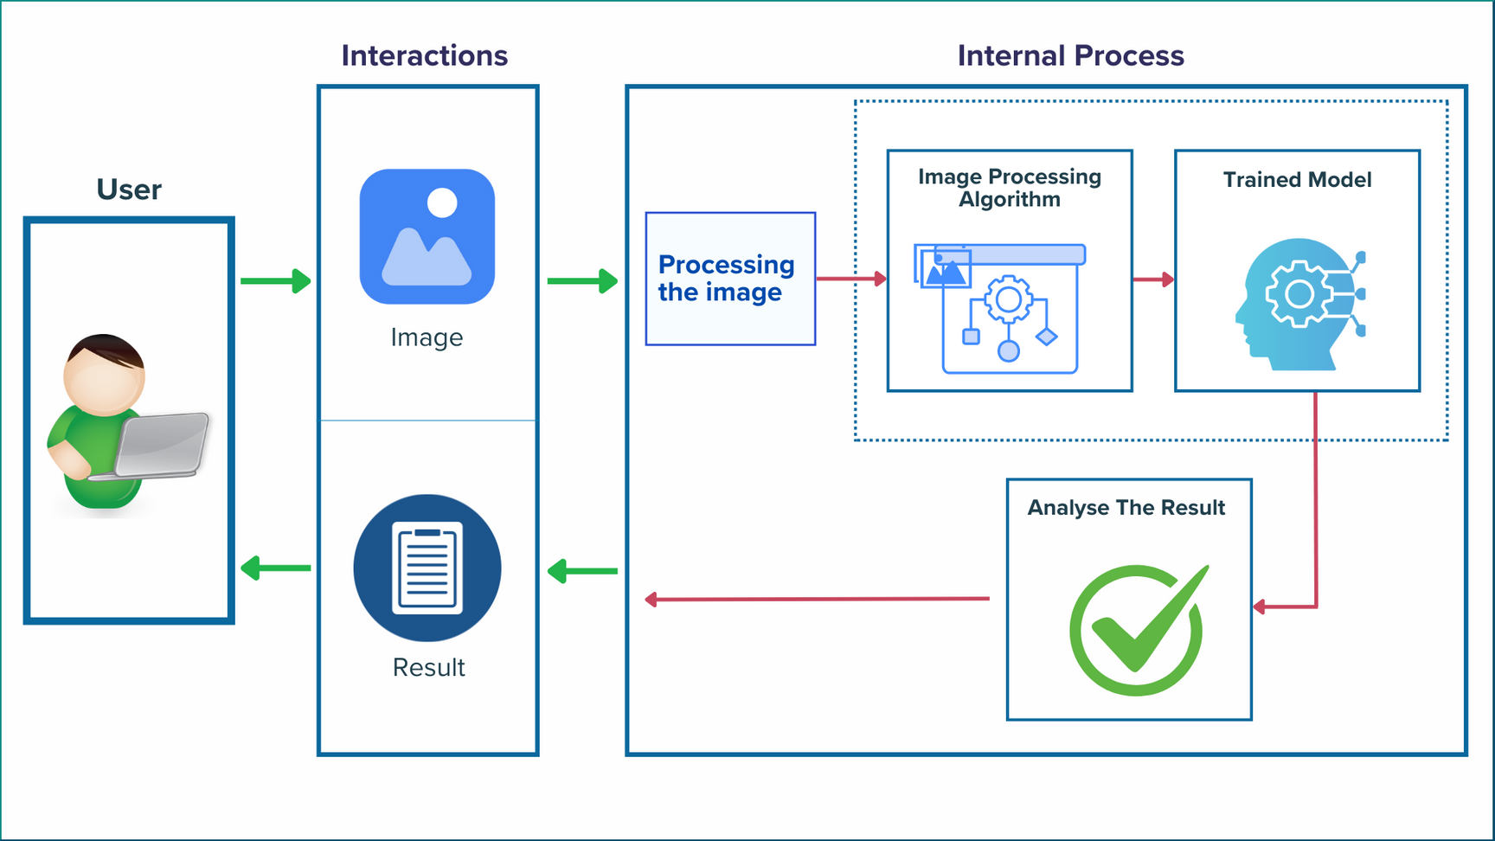
System Diagram

Slide 35
TOOLS & TECHNOLOGY
FRAMEWORKS
PROGARAMMING LANGUAGE
YOLO V8
Roboflow
Python
Next JS
DATABASE
OTHER TOOLS
Firebase
Google Colab
GCP
Figma
Draw.io
Canva
IT21085062 | Kajanan.T | R24-120
6 / 4 / 24
36

Slide 36
COMPLETION OF THE PROJECT
IT21085062 | Kajanan.T | R24-120
6 / 4 / 24
37

Slide 37

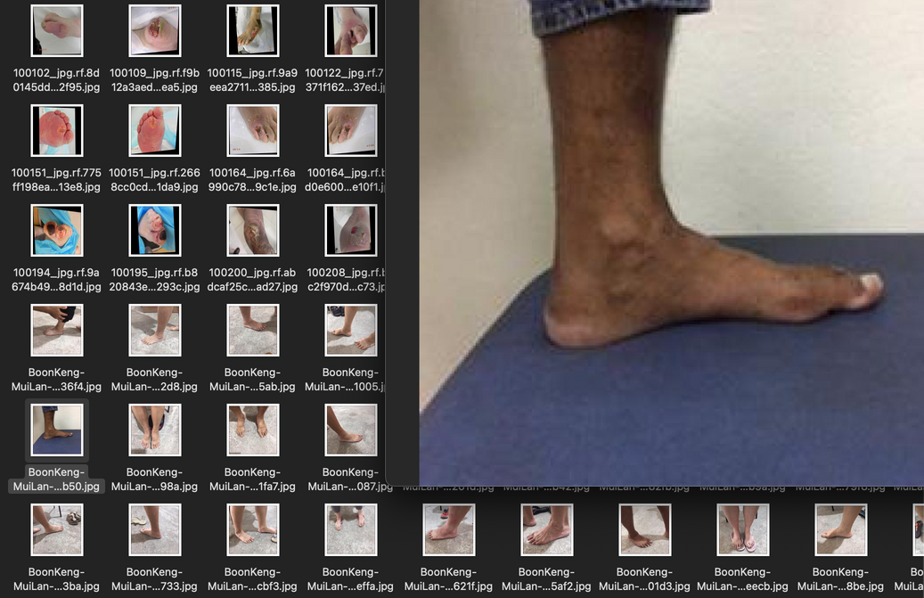

DATA COLLECTION
DATA COLLECTION
HOW
COLLECTED
Where
IT21085062 | Kajanan.T | R24-120
6 / 4 / 24
38

Slide 38

DATA ANNOTATION
Efficient tools for annotating data
Quick and accurate labeling process.
IT21085062 | Kajanan.T | R24-120
6 / 4 / 24
39

Slide 39
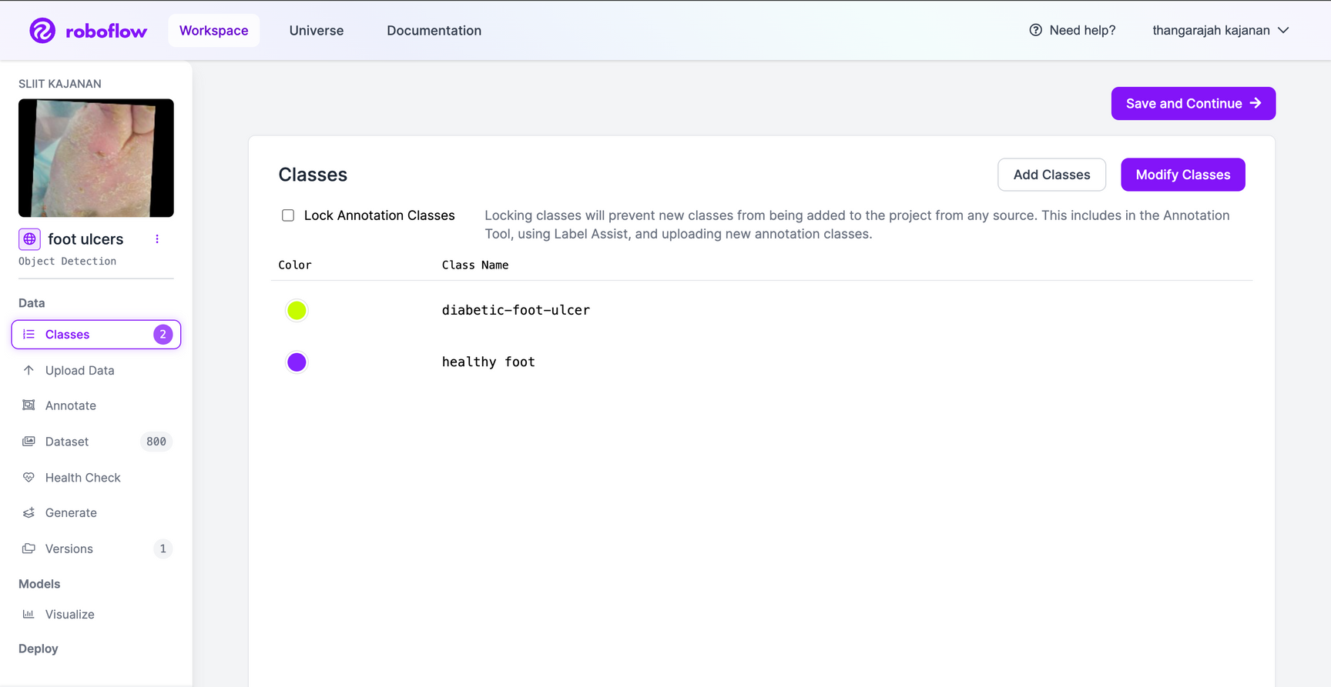


Create Class & Insert Data
IT21085062 | Kajanan.T | R24-120
6 / 4 / 24
40

Slide 40


Draw Bounding Boxes
Annotated Dataset
IT21085062 | Kajanan.T | R24-120
6 / 4 / 24
41

Slide 41


IMPLEMENT DATASEET
In Google Colab
IT21085062 | Kajanan.T | R24-120
6 / 4 / 24
42

Slide 42


MODEL TRAIN
In Google Colab
IT21085062 | Kajanan.T | R24-120
6 / 4 / 24
43

Slide 43


IT21085062 | Kajanan.T | R24-120
6 / 4 / 24
44

Slide 44



Final Prediction
IT21085062 | Kajanan.T | R24-120
6 / 4 / 24
45

Slide 45
FUTURE PLANS
Finalized Model Deployment and Testing
Increase the UI/UX of the Web application
IT21085062 | Kajanan.T | R24-120
7 / 4 / 24
46

Slide 46
Methiny S
BSc (Hons) in Information Technology Specialising in IT
Predicting Diabetes Through Nail Analysis
IT21083228
IT21083228 | Methiny.S | R24-120
7 / 4 / 24

Slide 47

OVERVIEW
Introduction
Objective
Research Problem
IT21083228 | Methiny.S | R24-120
7 / 4 / 24
47

Slide 48



INTRODUCTION
predict diabetes through the
analysis of infected nails.
IT21083228 | Methiny.S | R24-120
7 / 4 / 24
48

Slide 49



RESEARCH PROBLEM
lack of knowledge about how nail changes can indicate diabetes early.
How can we incresss the
awareness towards diabities
providing a handon solution which is available in day to day life.
IT21083228 | Methiny.S | R24-120
7 / 4 / 24
49

Slide 50
MAIN OBJECTIVES
SPECIFIC OBJECTIVES
Create a web application that can tell if someone might have diabetes by looking at pictures of their infected nails.
•Create a web application to detect diabetes using pictures of infected nails.
•Test the program on many nail pictures to confirm its accuracy for people with and without diabetes.
•Implement a user-friendly interface for accessibility.
IT21083228| Methiny.S | R24-120
7 / 4 / 24
50

Slide 51
METHODOLOGY
System Diagram
Tools & Technology
Completion of Project
IT21083228| Methiny.S | R24-120
7 / 4 / 24
51

Slide 52

System Diagram

Slide 53
TOOLS & TECHNOLOGY
FRAMEWORKS
PROGARAMMING LANGUAGE
CNN (custom CNN)
Taildwind CSS
Python
Next JS
DATABASE
OTHER TOOLS
Firebase
Google Colab
GCP
Figma
Draw.io
Canva
IIT21083228| Methiny.S | R24-120
7 / 4 / 24
53

Slide 54
COMPLETION OF THE PROJECT
IT21083228| Methiny.S | R24-120
7 / 4 / 24
54

Slide 55

DATA COLLECTION
HOW
COLLECTED
Where
IT21083228| Methiny.S | R24-120
7 / 4 / 24
55

Slide 56


Final Prediction
IT21083228 | Methiny.S | R24-120
7 / 4 / 24
61

Slide 57
FUTURE PLANS
Final Testing & Integration
Increase the a Front-end Quality
IT21083228 | Methiny.S | R24-120
7 / 4 / 24
62

Slide 58

VENUGANTH A
BSc (Hons) in Information Technology Specialising in IT
Detect signs of retinopathy in diabetic patients' eye scans using image analysis techniques and stage prediction
IIT21085062
IT21102646

Slide 59


DIABETIC RETINOPATHY
IT21102646 | Venuganth.A | R24-120
7 / 4 / 24
64

Slide 60

01. INTRODUCTION
Diabetic retinopathy is a serious eye condition that can lead to vision loss and blindness in individuals with diabetes. It affects the blood vessels in the retina, which is the tissue at the back of the eye responsible for vision. High blood sugar levels in diabetes can damage these blood vessels, causing them to weaken and leak. This damage can result in various vision problems, from blurred or double vision to eventual blindness.
IT21102646 | Venuganth.A | R24-120
7 / 4 / 24
65

Slide 61
02.
RESEARCH PROBLEM
Annual retinal screenings encounter challenges with patient adherence, with reported rates ranging from 30-60%.
Existing screenings using ophthalmoscopy struggle with low quality, impacting the reliability of diabetic retinopathy examinations.
Compliance is hindered by factors such as income levels, inadequate health insurance, and time constraints.
Insufficient specialist referral systems, a shortage of eye care providers, and inadequate public health funding contribute to the challenges faced in current screenings
IT21102646 | Venuganth.A | R24-120
7 / 4 / 24
66

Slide 62
03.
RESEARCH GAP
Long-term Effectiveness : Assessing the sustainability of the program over a more extended period and whether the benefits
Patient Outcomes and Satisfaction :Satisfaction of the patients with the process, any improvements in health outcomes, and potential barriers to participation
Quality Assurance and Accuracy: The quality of the system should be accurate to predict diabetes and the data should be reliable
IT21102646 | Venuganth.A | R24-120
7 / 4 / 24
67

Slide 63
04.
OBJECTIVES
Main Objective
To detect signs of retinopathy in diabetic patients' eye scans using image analysis techniques and stage prediction
Sub Objectives
•To provide users with a reliable tool for diagnosis of diabetes.
•To identify the stage of diabetic retinopathy
•To reduce the risk of vision loss associated with diabetic retinopathy
IT21102646 | Venuganth.A | R24-120
7 / 4 / 24
68

Slide 64
05.
METHODOLOGY
INDIVIDUAL SYSTEM ARCHITECTURE
TOOLS AND TECHNOLOGIES
REQUIREMENTS
CURRENT PROGRESS
NEXT EXPECTED PROGRESS
IT21102646 | Venuganth.A | R24-120
7 / 4 / 24
69

Slide 65

06. SYSTEM ARCHITECTURE
IT21102646 | Venuganth.A | R24-120
7 / 4 / 24
69

Slide 66
07.
TOOLS AND TECHNOLOGIES
Language : Python
Frontend : NextJS
Libraries : Tensorflow, CNN, Seaborn, Matplotlib, Keras
IT21102646 | Venuganth.A | R24-120
7 / 4 / 24
71

Slide 67
08.
REQUIREMENTS
Functional Requirements : Extract images from scanned images
Non Functional Requirements : Accuracy, Speed, Scalability, Reliability
System Requirements : Any IOS or Android devices with 2GB of RAM, Camera, and internet connectivity.
User Requirements : Simple interface, Easy to operate
IT21102646 | Venuganth.A | R24-120
7 / 4 / 24
72

Slide 68
09.
CURRENT PROGRESS
Acquired a dataset to ensure the model produces precise predictions
Utilizing the image processing algorithms, I've constructed a prediction model.
Trained the model to have an accuracy 98% in predicting Diabetic Retinopathy.
Implemented the frontend and backend of the web application and tested the API
IT21102646 | Venuganth.A | R24-120
7 / 4 / 24
73

Slide 69
10.
NEXT EXPECTED PROGRESS
•Application Deployment
•Integration of the frontend with backend
IT21102646 | Venuganth.A | R24-120
7 / 4 / 24
74

Slide 70

11.1 DATASET PREVIEW
IT21102646 | Venuganth.A | R24-120
7 / 4 / 24
75

Slide 71

11.2 DATASET PREVIEW
IT21102646 | Venuganth.A | R24-120
7 / 4 / 24
76

Slide 72

12.1 COMPLETION OF CODE
IT21102646 | Venuganth.A | R24-120
7 / 4 / 24
77

Slide 73

12.2 COMPLETION OF CODE
IT21102646 | Venuganth.A | R24-120
7 / 4 / 24
78

Slide 74

13.3 COMPLETION OF CODE
IT21102646 | Venuganth.A | R24-120
7 / 4 / 24
79

Slide 75

13.4 COMPLETION OF CODE
IT21102646 | Venuganth.A | R24-120
7 / 4 / 24
80

Slide 76


14.1 EXAMPLE OF PREDICTED IMAGES
IT21102646 | Venuganth.A | R24-120
7 / 4 / 24
81

Slide 77


14.2 EXAMPLE OF PREDICTED IMAGES
IT21102646 | Venuganth.A | R24-120
7 / 4 / 24
82

Slide 78



14.3 EXAMPLE OF PREDICTED IMAGES
IT21102646 | Venuganth.A | R24-120
7 / 4 / 24
83

Slide 79

15 INTEGRATION WITH FLASK API
IT21102646 | Venuganth.A | R24-120
7 / 4 / 24
83

Slide 80

16 INTEGRATION WITH NGROK
IT21102646 | Venuganth.A | R24-120
7 / 4 / 24
83

Slide 81

17 TESTING THE API
IT21102646 | Venuganth.A | R24-120
7 / 4 / 24
83

Slide 82

18 STORING THE API URL IN FIREBASE
IT21102646 | Venuganth.A | R24-120
7 / 4 / 24
83

Slide 83

19.WORK BREAKDOWN STRUCTURE
IT21102646 | Venuganth.A | R24-120
7 / 4 / 24
84

Slide 84

7 / 4 / 24
85

Slide 85
THANK YOU!
7 / 4 / 24
86

